Slide 1

Parking Enforcement in City of Toronto
Analyzing 10 years of data from the year 2011 to 2020 to generate insights and find out patterns in parking enforcement in Toronto.
By:
Isha Arora

Slide 2

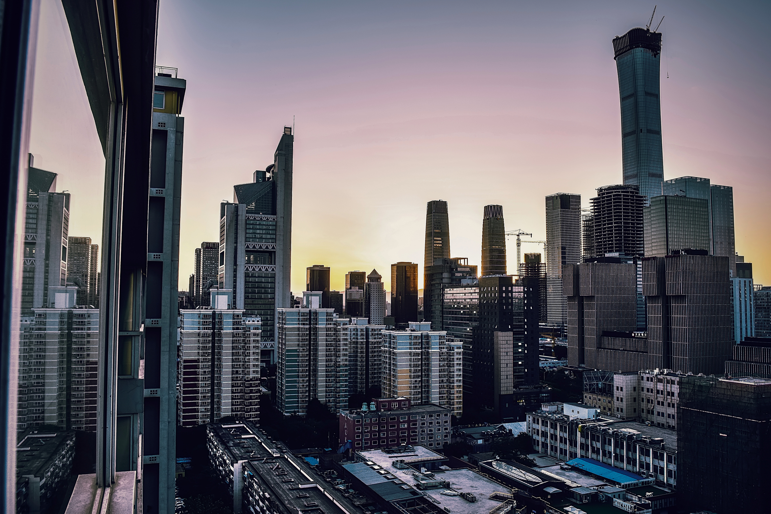
CONTENT
01
02
03
04
Introduction
Problem Statement
Objectives
Methodology
08
05
06
07
Data Insights & Analytics
Recommendations
Limitations of my Analysis
Conclusion

Slide 3
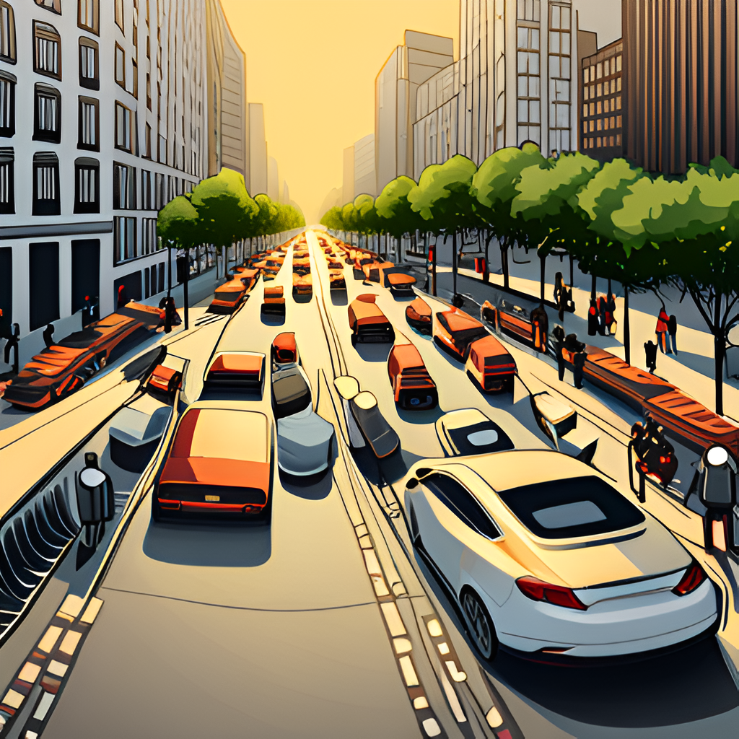
BACKGROUND AND PROBLEM STATEMENT
The City of Toronto, with a population of 2.93 million, faces unique challenges in managing parking within its urban environment
Efficient parking management is important for maintaining traffic flow, preventing congestions and accidents, and also ensuring effective access to essential services
However, inefficient parking enforcement practices have led to a range of issues affecting both citizens and the city administration."

Slide 4
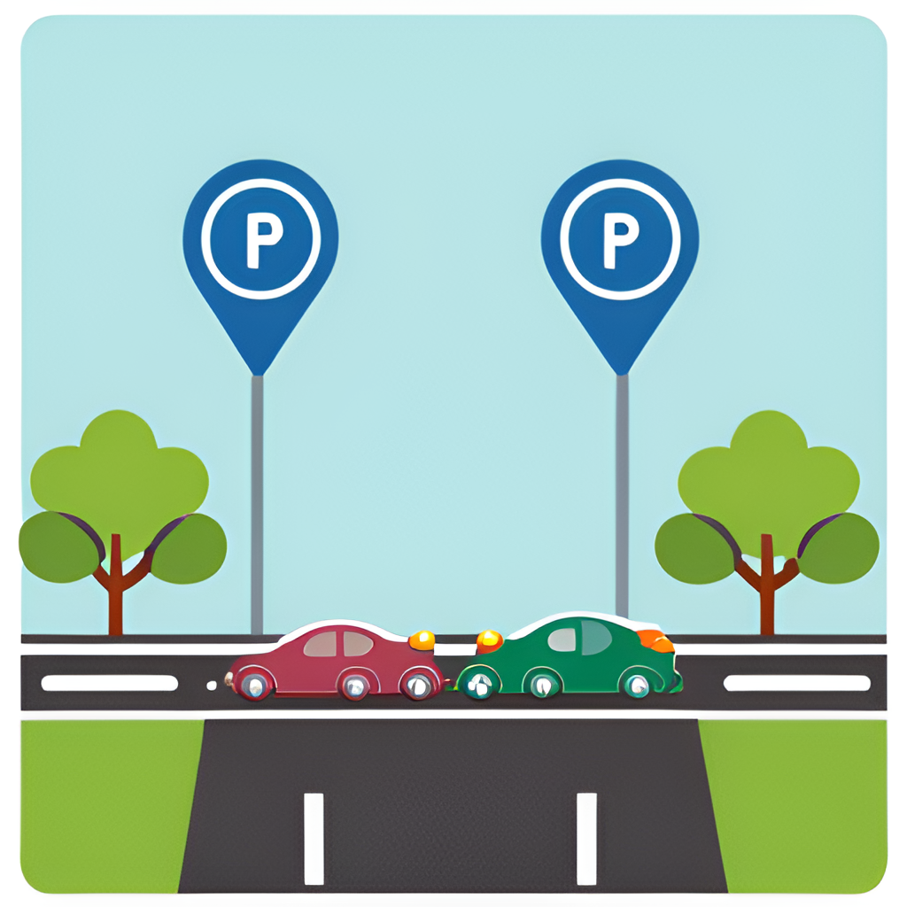
OBJECTIVES OF THE ASSESSMENT
The objectives of this take-home assessment were to analyze the current parking enforcement methods, identify challenges, and propose effective recommendations
The data was given from 2011 to 2020 in different csv files and the goal was to analyze the data using any BI tool.
This Analysis will establish a foundation for informed decision-making and continuous improvement in parking management that will optimize resource allocation, reduce congestion, and improve user experience.

Slide 5


METHODOLOGY
Approach and Methodology:
Combined Data Collection, Cleaning, and Exploratory Data Analysis
Generated insights on Parking Enforcement trends in Toronto using Python and its inbuild libraries like matplotlib
Extracted Data from website and combined all 15 CSV files to get a single dataset for 10 years.
EDA & Data Analysis:
Identified missing values and outliers in the data, and cleaned the data.
Conducted various Analytical Tasks:
Infraction Analysis
Hotspot/Location Analysis
Time Series Analysis
Revenue Generation Analysis

Slide 6
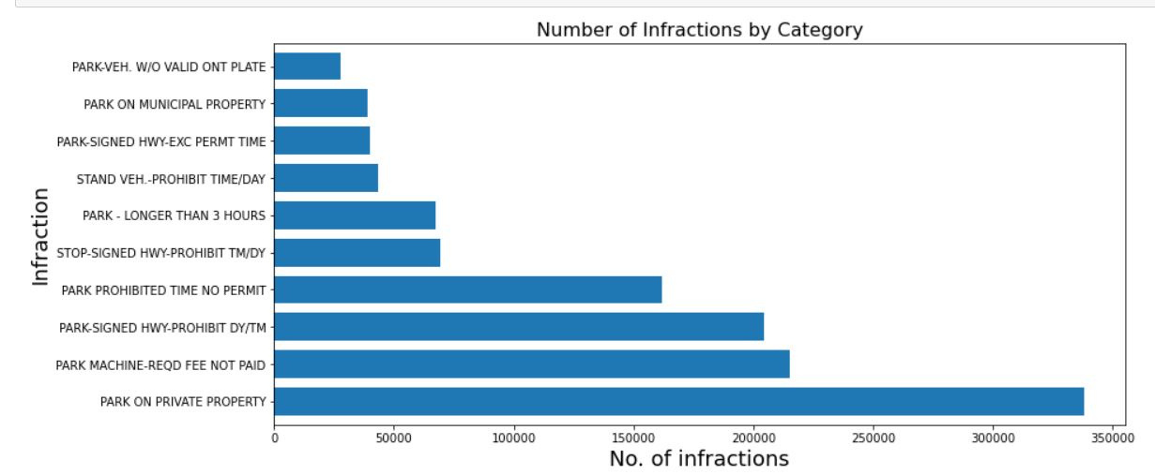
DATA ANALYTICS INSIGHTS
Infraction Analysis:
Let us see a graph that on which infraction categories there have been the most number of tickets issued.
The graph here shows the Top 10 Categories with their count on which the tickets were issued.
The highest number of tickets generated is for the category "PARK ON PRIVATE PROPERTY".

Slide 7
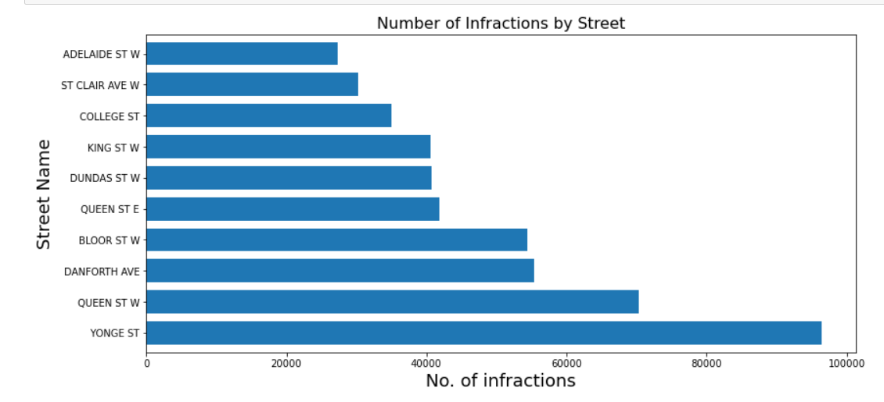
DATA ANALYTICS INSIGHTS
Hotspot Analysis:
Hotspot Analysis can be used to analyze the areas where the most number of tickets are issued, which can often lead to a conclusion of the capacity of the parking in that specific area.
Using the Location_2 Column of the dataset, I have found the street names where the most number of tickets are issued.
The graph shows the TOP 10 Streets of Toronto where the most number of tickets were issued.

Slide 8
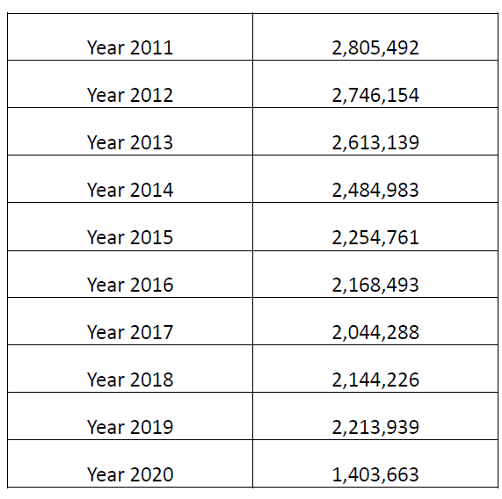
DATA ANALYTICS INSIGHTS
Yearly Analysis:
I have calculated the number of tickets generated each year from 2011 to 2020
From 2011 to 2017 there was a slight decrease in the number of tickets generated
The number of tickets started to rise in 2018, that might be because Canada has welcomed the highest number of immigrants in history.
Also, there was a deduction of almost 60% in 2020, where COVID is to be blamed

Slide 9
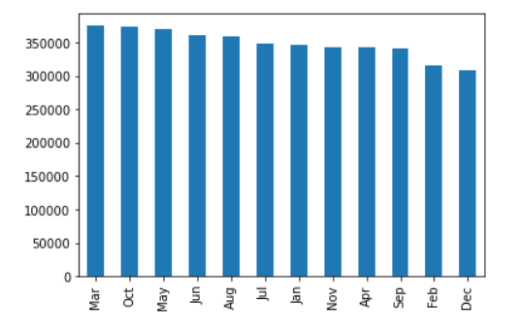
DATA ANALYTICS INSIGHTS
Month-by-Month Analysis:
Analyzing monthly trends allows us to assess the effectiveness of specific policies or initiatives over time and also helps to lookout the seasonal variations about peak months.
However, there is no low or high peak month, but the tickets generated in December are comparatively low.
Reasons might include but not limited to , there are more number of Holidays in December than any other month.

Slide 10
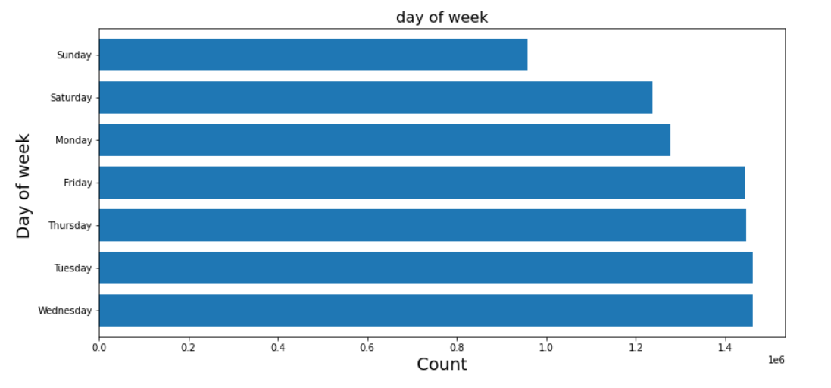
DATA ANALYTICS INSIGHTS
Weekly Analysis:
Based on the date given, added a new column called "day_of_week" to find if there is any co-relation between the number of tickets generated and the particular day.
Sundays have the least number of tickets generated
Reasons might include:
The offices are closed, making more parking space available for the tourists.

Slide 11
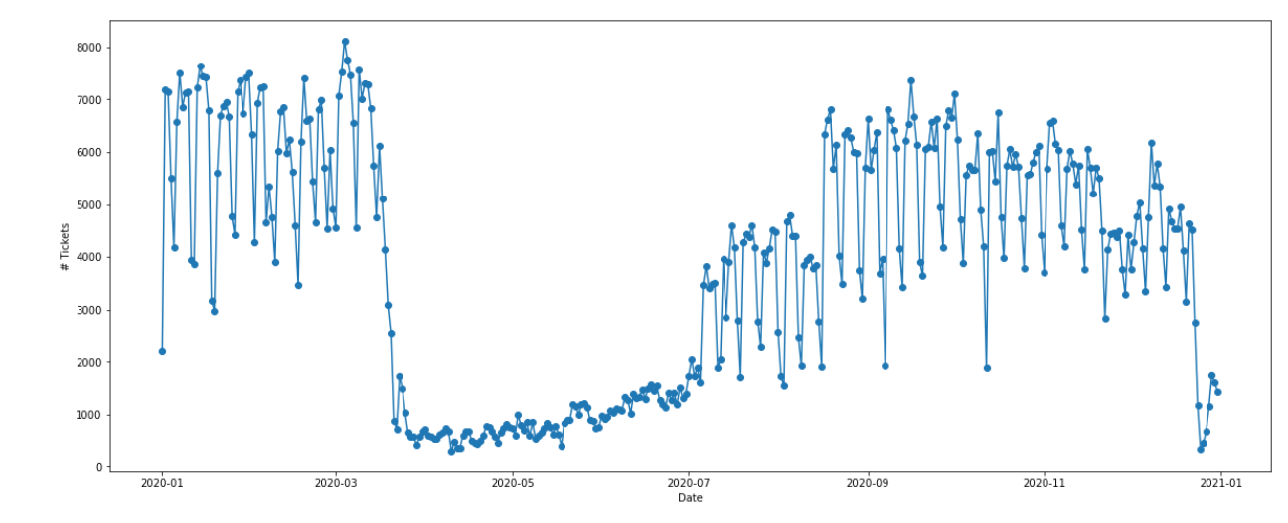
DATA ANALYTICS INSIGHTS
Year 2020 Analysis:
I have created a graph to check the number of parking enforcement in the year 2020 and how drastically is has dropped.
We can see that during the 1st wave of COVID, especially between march and July, the number of tickets is less than 1000.
The reasons are that people preferred to stay indoor and many business started remote work.

Slide 12
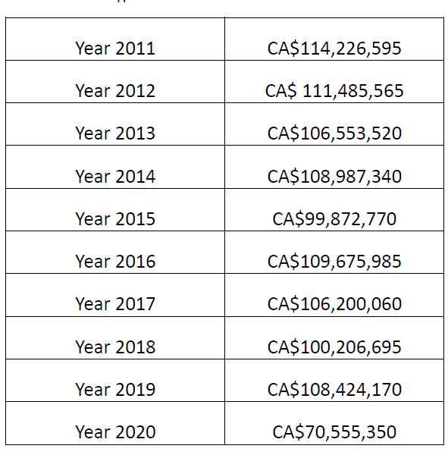
DATA ANALYTICS INSIGHTS
Revenue Genration Analysis:
I have calculated the revenue generated each year from 2011 to 2020 in CA$, using the fine_amount in the given data.
Compared with 2013, the number of tickets issued in 2014 decreased by 5%, but the original face values increased by 2.3% during the same period.
This might be because the TPS added a new type of parking ticket infraction “STOP SIGNED HIGHWAY-RUSH HOURS” in 2014 and 55,609 tickets were issued under this infraction

Slide 13
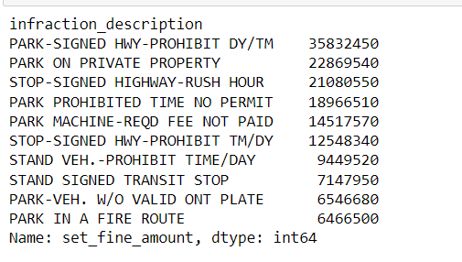
DATA ANALYTICS INSIGHTS
Revenue Generated per Infraction
Let us see a table for 10 categories based on the revenue generated.
The highest revenue collected is for PARK SIGNED HWY_PROHIBIT DY/TM with a face value of CA$ 35.8 million followed by PARK ON PRIVATE PROPERTY.

Slide 14

RECOMMENDATIONS
Traffic Police should collaborate with the City Administrators to find out the insights and should arrange for more Police at hotspot locations like Yonge and Queen Street.
The parking fee machine should be checked and maintained regularly to ensure it's working properly.
The city of Toronto can also implement a system for the public to provide feedback on parking-related issues and report violations.
Also, collaborate with city planners to design parking-friendly urban layouts and optimize parking space allocation.

Slide 15
LIMITATIONS OF MY ANALYSIS
Due to Time format in the given datatset, I was unable to find out peak hour of the day. Getting to know which time of the day, the highest number of tickets issued can help us to look more closer into the insights.
Knowing the peak hours, a city can arrange more Traffic Police during those rush hours and thus reducing number of parking violations.
Apart from that, if had a chance, I would create an interactive Dashboard using Tableau and would also add filters based on month, year, and type of infraction, which becomes effortless for a non technical person to look for the patterns.

Slide 16
CONCLUSION
Bringing our analysis of parking enforcement in the City of Toronto to a close, I want to emphasize the significance of our findings and the actionable recommendations we have discussed.
Throughout this analysis, we looked into the heart of parking enforcement dynamics, exploring patterns, trends, and influencing factors. Our journey through weekly and month-by-month analysis, identification of hotspot areas, examination of violation types, and revenue assessment has yielded a wealth of insights that can transform our approach to parking management.

